Slide 1

Online Collaboration System
Here is where your presentation begins

Slide 2
Table of Contents
1
2
3
4
Introduction
Objectives
Designs
Technology Used
6
5
Outcomes
Screenshots

Slide 3
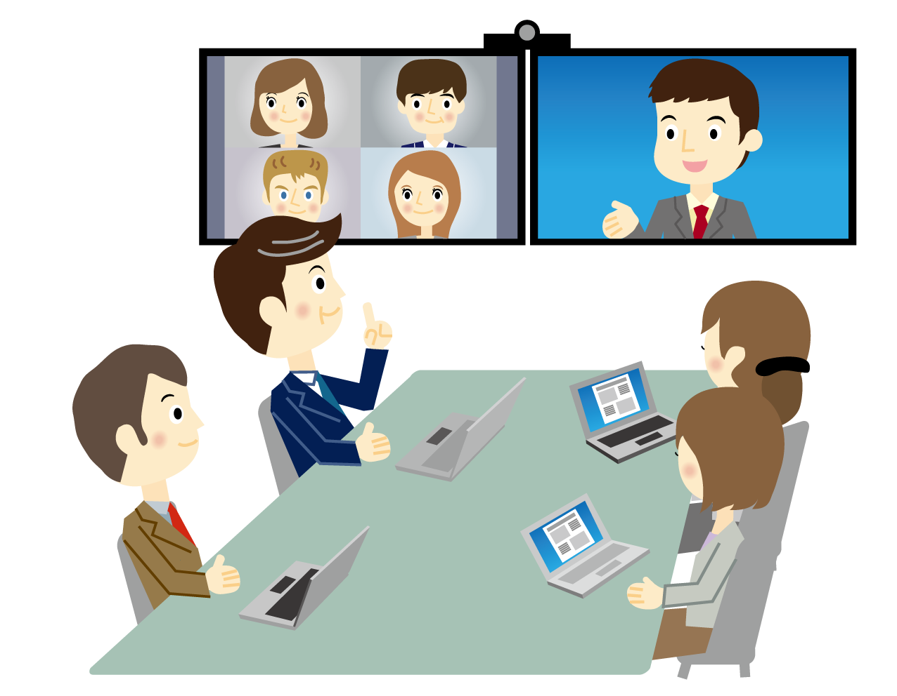
Video Collaboration
Video collaboration is a live video-based meeting between two or more people in different locations using video-enabled devices.
Video collaboration allows multiple people to meet and collaborate face to face long distance by transmitting audio, video, text and presentations in real time through the internet.

Slide 4

Role of Collaboration During Pandemic
The COVID-19 pandemic and the resulting stay-at-home orders have led to significant changes in the way people work. One of these changes involves increased use of video conferencing as a means of communicating or holding work meetings. Zoom, for instance, had 10 million daily meeting participants in December 2019, but by April 2020, that number had risen to over 300 million. Other video conferencing platforms, such as Google Meet™ and Microsoft Teams, have also experienced significant increases in daily participants
Key Points:
Continuing To Work
Back To The Office?
Family and Friends

Slide 5

Exsisting Collaboration Probelms
1. Download required to join the meeting
Many web conferencing solutions make participants download an application to join the meeting Downloads take time and pose significant friction to your meeting participants.
.
2. Conferencing tool lacks modern audio conferencing technology
Some free video conferencing platforms don’t use the latest available technology. Older online meeting platforms might also use outdated
audio technology.
3.Lack of experience with online meeting technology

Slide 6

4.Trouble joining by phone
Joining online meetings from your phone can sometimes be a painful experience. It usually involves digging through your email for the phone number. Then you need to find the appropriate local dial-in number. You have to call that and then find and enter a PIN number..
5. Sensitive data accidentally being shared
We’ve all been in a meeting where sensitive email notifications or private chats popped up in the corner.
It happens so often that there are entire businesses tackling this problem. Sensitive data might also be shared when switching between documents and tabs while screen sharing.
6.Lack of experience with online meeting technology
Many people are new in this online collaboration system and They don’t have experience with online collaboration tool before. So it is quite difficult for new users to get used to this collaborative environment.

Slide 7


Objective of Our Project
Improves communication
Helps build relationships a
Saves money
Saves time
Streamlines collaboration
Improves efficiency
Increases productivity
Makes scheduling meetings easier
Creates consistent, accurate records
Enables live events

Slide 8






Technologies Used
React js - its is a free and open-source front-end JavaScript library for building user interfaces based on UI components
Node.js is an open-source, cross-platform, back-end JavaScript runtime environment that runs on the V8 engine and executes JavaScript code outside a web browser.
WebRTC is a free and open-source project providing web browsers and mobile applications with real-time communication via application programming interfaces.
Peer-JS wraps the browser's WebRTC implementation to provide a complete, configurable, and easy-to-use peer-to-peer connection API
EJS is a simple templating language that lets you generate HTML markup with plain JavaScript
WebSocket is a computer communications protocol, providing full-duplex communication channels over a single TCP connection.

Slide 9
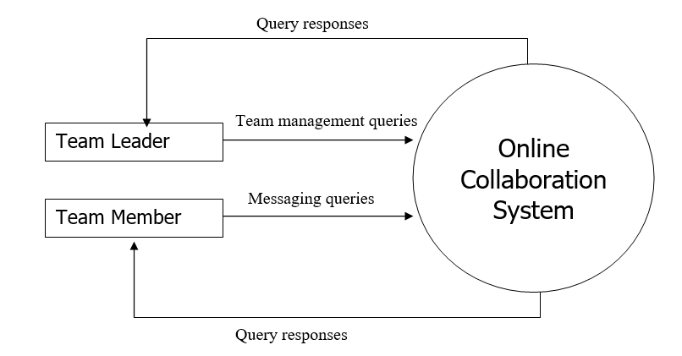
DESIGNS

Slide 10
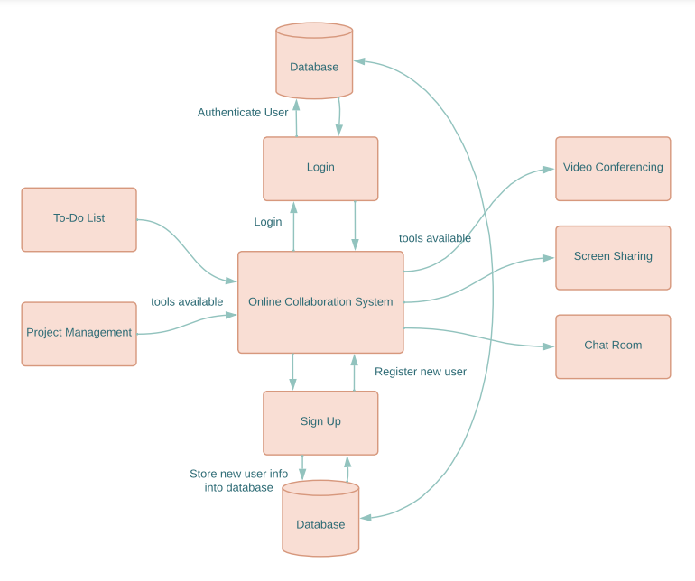
DESIGNS

Slide 11
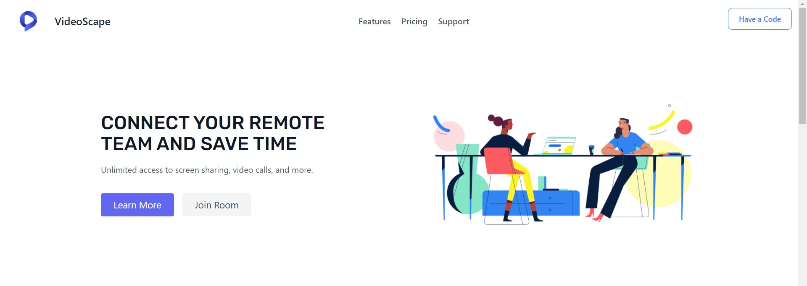
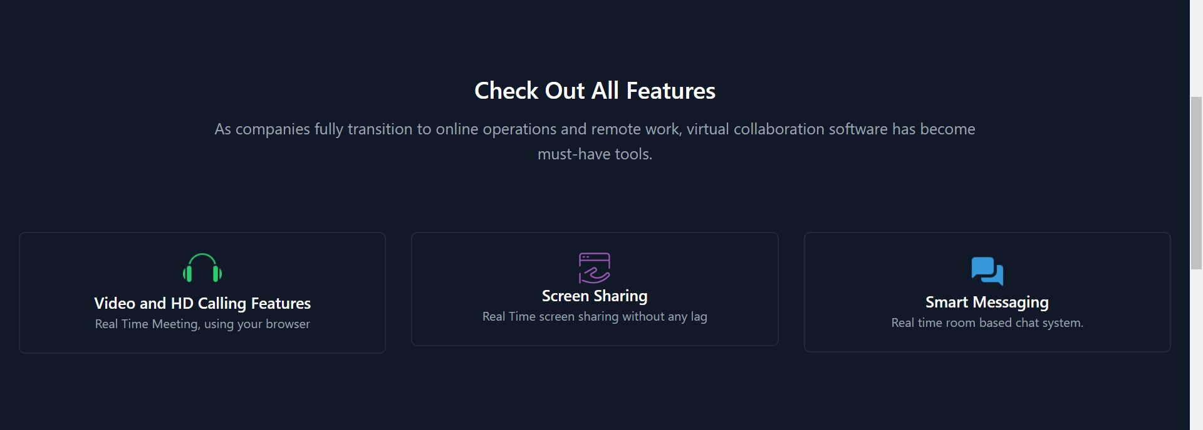
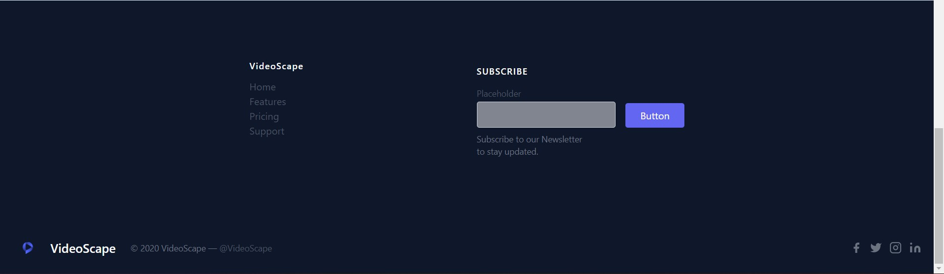
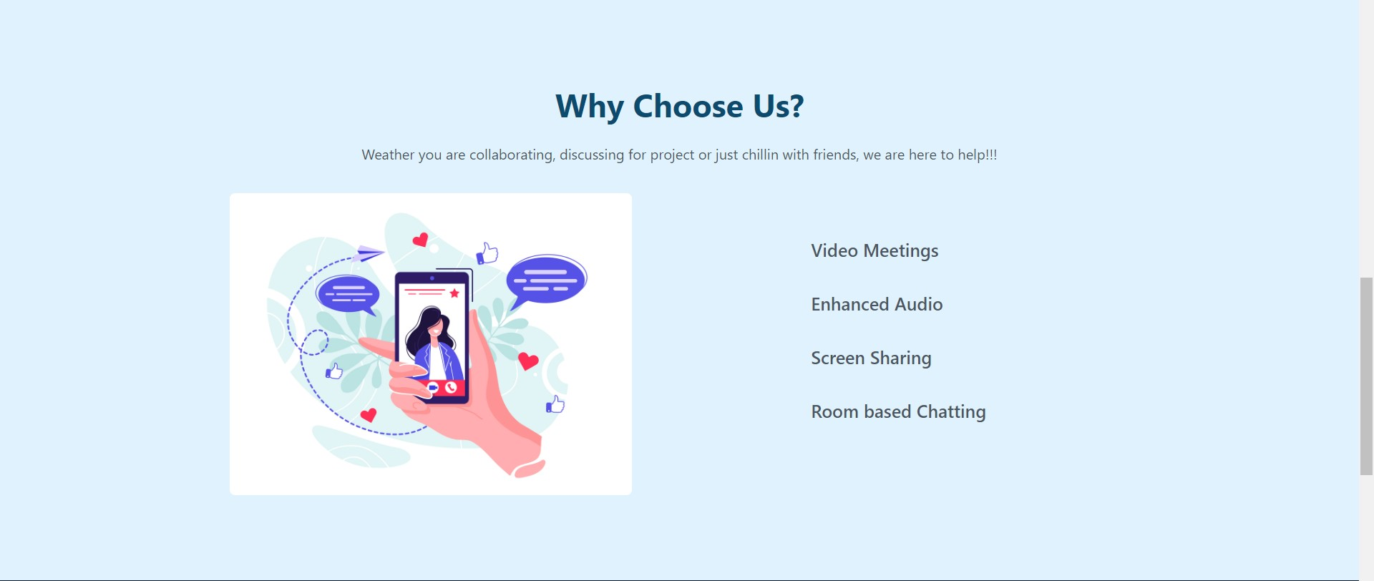
Design

Slide 12
OUTCOMES
The online collaboration system has 3 major modules and some other minor modules.
Team Management: A team is a group of members selected to work together by the leader, who is also a member
Messaging System: The messaging part in online collaboration system allows members to communication and beware of what’s going on in the system.
Project Management System: Managing a project involves many different aspects and many things that have to be tracked and followed up upon.

Slide 13

THANKS
Shivangi Pathak
20BCS4854
Aditya Choudhary
20BCS5188
Mohit Mittal
20BCS4858
Krishna Kant Narayan
20BCS3893
Deepshikha Kumari
20BCS5297

